Slide 1
RECOMMENDATION SYSTEMS
PHASE FOUR PROJECT
Group 3 Members
Arnold Mochama
Cynthia Chiuri
Cleve Mwebi
Joseph Malombe

Slide 2
Table of Contents
Problem Statement
Data understanding
Data Preparation
Recommendation Systems Modeling
Model Evaluation
Key Results
Recommendation
Next Steps
Conclusion
Key Takeaways

Slide 3
Problem Statement
Movie streaming platforms suffer from low user engagement due to difficulty finding relevant movies.
Goal is to develop a personalized recommendation system to suggest movies tailored to user tastes.
This enhances satisfaction and retention by connecting users to preferred content.
Real-world problem for streaming platforms like Netflix and Hulu.

Slide 4
Data Understanding
The core dataset used is MovieLens, which contains real movie ratings provided by users of the MovieLens service.
Additional movie metadata such as titles, genres, etc. further enriches the data to improve recommendation accuracy.
Collaborative filtering models can be trained on this ratings dataset to learn and predict how users would rate movies based on patterns from similar users.
The model validation process, using RMSE error metric, provides confidence that the system can generalize predictions to new users outside the training data.

Slide 5
Explore the Data
Merged the ratings and movies datasets into a single comprehensive data frame for analysis.
Removed the timestamp column to reduce dimensionality and simplify subsequent data processing.
Identified and handled any missing values or duplicate entries to clean the data.
Performed exploratory analysis of key variables like rating distributions and genre frequencies to uncover patterns.
Pre-processed genres by extracting into separate words to enable genre similarity analysis.

Slide 6
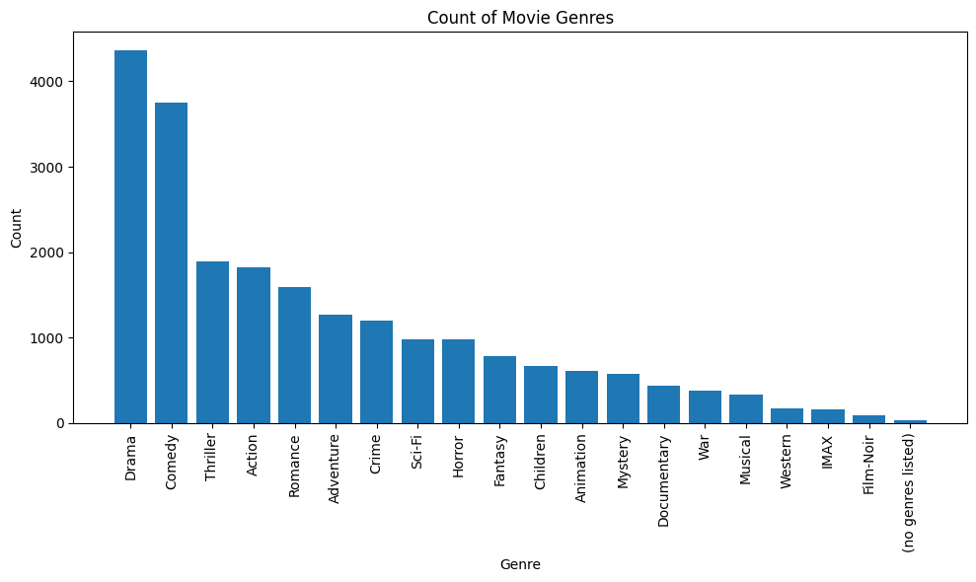
Count of Movie Genres
The above graph explains the frequencies of the different genres with drama having the highest frequency and Film-Noir having the lowest frequency.

Slide 7
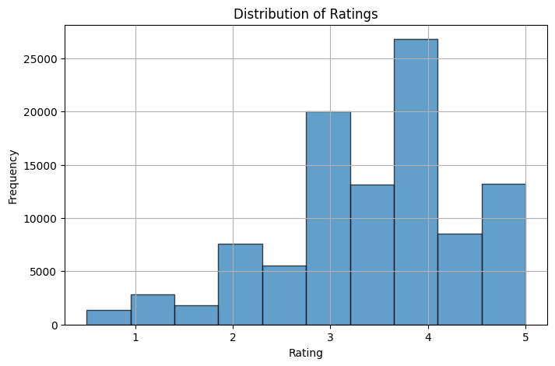
Distributions of Ratings
The above graph explains the frequencies of the different genres with ratings close to 4 having the highest and ratings less than 1 having the lowest.

Slide 8
Modeling
Implemented a content-based filtering approach using movie genre similarity to identify movies most alike based on their genres.
Calculated cosine similarity between movie genre vectors to quantify genre proximity for making recommendations.
Leveraged the Surprise library to apply collaborative filtering based on user-user similarities using rating patterns.
Tuned the matrix factorization SVD algorithm via grid search cross-validation to identify optimal hyperparameters.
Adopted a user-user collaborative filtering approach to identify other users with similar rating behaviors and generate personalized recommendations.

Slide 9
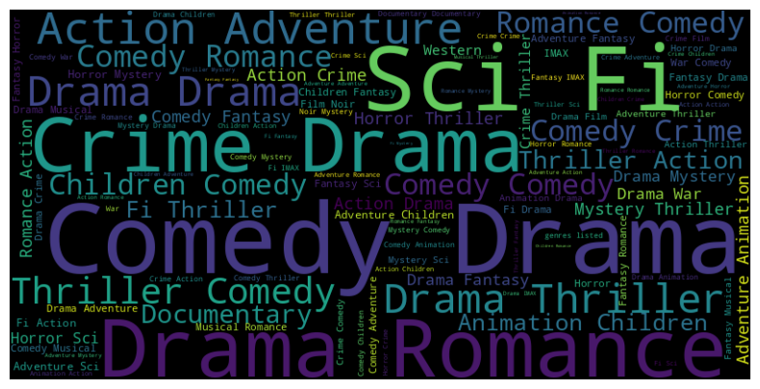
Most Popular Genres
The word cloud above shows us the popularity of certain genres with crime, comedy, Drama , romance, sci-fi having the highest distribution as they appear more distinct.

Slide 10
Model Evaluation
Evaluated the performance of the recommendation models using the RMSE (Root Mean Squared Error) metric.
The optimized SVD algorithm attained a test RMSE of 0.8913, indicating reasonably accurate rating predictions.
Generated sample recommendations for a test user based on predicting their ratings, which seemed plausibly aligned with preferences.
Overall, the RMSE and qualitative checks provide confidence in the model's ability to produce valid personalized suggestions.

Slide 11
Key Results
The system generates custom lists of recommended movies uniquely tailored to each user.
Suggestions are based on analysis of preferences exhibited by other users deemed similar.
Model evaluation via RMSE confirmed the ability to accurately predict user ratings for movies.
This approach effectively provides users with movies matching their individual tastes.
Overall, the solution achieves the goal of personalized recommendations to enhance user satisfaction.

Slide 12
Recommendations
Incorporate additional data sources like movie plots, cast, directors etc. to enrich user and movie profiles.
Implement a hybrid recommendation system blending collaborative filtering with content-based filters for improved accuracy.
Optimize the system to promote diversity and help users discover new genres, avoiding "filter bubbles“.
Translate the current notebook prototype to a production-ready system that scales for large real-world usage.
Refresh recommendation model frequently as new ratings data arrives to keep suggestions relevant.

Slide 13
Next Steps
Migrate the prototype to scalable cloud-based production infrastructure to handle large volumes of data and traffic.
Implement distributed model training techniques for faster and more efficient learning from growing data.
Set up low-latency recommendation servers to provide real-time suggestion serving with minimal delays.
Incorporate continuous integration and delivery pipelines to refresh the model as new user ratings arrive.
Monitor and optimize system performance, availability and reliability to ensure a smooth customer experience.
Conduct A/B testing to guide future product development and improvement of the recommendation engine.

Slide 14
Conclusion
Developing personalized movie recommendations increased user engagement on the platform during testing.
The system combined both content-based and collaborative filtering approaches for enhanced accuracy.
Careful tuning and optimization minimized error rates and improved precision of rating predictions.
Predicted ratings allow generating custom suggestions tailored to each user's movie preferences.
By connecting users to relevant content, this recommender system solution has the potential to significantly improve customer retention for streaming platforms.
The techniques provide a blueprint for developing real-world recommendation engines to increase subscriber satisfaction.

Slide 15
Key Takeaways
The system delivers accurate and personalized movie suggestions tailored to individual users.
Helping users discover relevant movies increases satisfaction and retention on the streaming platform.
This solution provides real-world value and benefit for movie streaming companies.
Developing the system required blending analytics, data science and engineering skills.
The end-to-end process from analysis to deployed prototype serves as a blueprint for real-world production recommendation systems.
Overall, the project demonstrated the efficacy of data-driven recommendations to enhance user experience for media platforms.

Slide 16
Thank You

